Slide 1
Heartbeat
Mission 6

Slide 2

Pre-Mission Preparation
You have probably seen flashing traffic road signs or traffic lights.
In the Mission 6 log, answer the pre-mission preparation questions:
Make a list of blinking indicators (like flashing traffic road signs)

Slide 3

Mission 6: Heartbeat
In this project you'll give the CodeX a beating heart.
Okay, not a real heart - that would be a little too messy!
But using the display you can give the CodeX its own digital heart, and even make it speed up and slow down just like your own heart does.

Slide 4
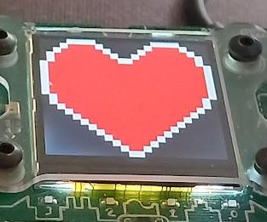
Objective #1: Lots of heart
Review programming concepts from your earlier missions.
Start by showing a heart image on the screen.
You might recognize this as the same code as your first project.
Don't worry, you're going to add a lot of new features soon!

Slide 5
Mission Activity #1
DO THIS:
Start a new file named Heart2
Show pics.HEART on the CodeX display
  Use CodeTrek if you need help

Slide 6
Objective #2: Pump it UP
Now you will animate the heart to make it look like it is beating.
You will need two heart images:
  pics.HEART
  pics.HEART_SMALL
You need a delay variable to see both images
You need to import sleep to use the delay variable

Slide 7
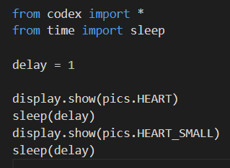
Mission Activity #2
DO THIS:
From time, import sleep
Define a delay variable
Show the first heart
  Then sleep
Show the second heart
  Then sleep

Slide 8
Objective #3: Repeat da beat
Now you have a heartbeat.
But one heartbeat isn’t an animation.
You can repeat the code to repeat the heartbeat several times

Slide 9
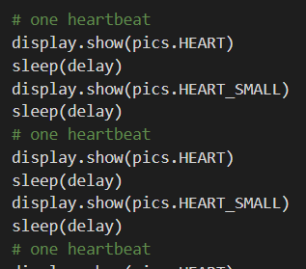
Mission Activity #3
DO THIS:
Repeat the code for the large and small hearts at least 4 times

Slide 10
Objective #4: Hearts forever
Four beats is a good animation, but it ends.
We want our heart animation to run forever.
You can’t just copy millions of times
Tell the computer to repeat the code
Repeating code without retyping is called a LOOP

Slide 11
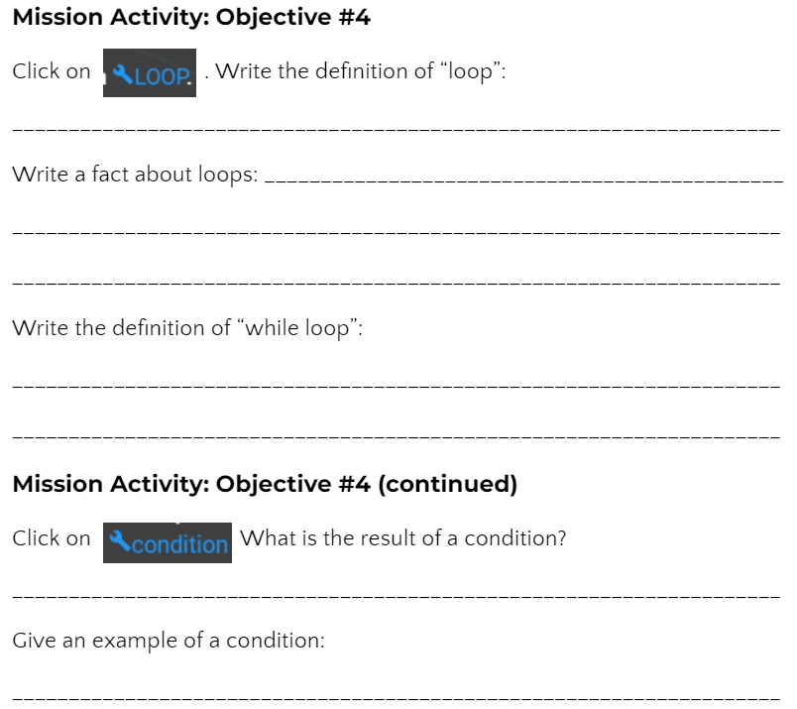

Mission Activity #4
DO THIS:
Click on
Go to your Mission Log and answer the questions for Objective #4
Click on
Go to your Mission Log and answer the questions for Objective #4

Slide 12
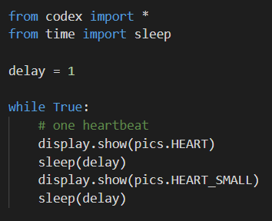
Mission Activity #4
Modify your code
DO THIS:
Delete all the repeated code except the first heartbeat
Add a while loop to the code
  Type a colon (:) at the end of the line
  Indent the heartbeat code
  Use the TAB key to indent your heartbeat code
Run the code
  You will need to click “STOP RUNNING”
  to end the code.

Slide 13

Objective #5: Stop it!
A while loop that goes forever without stopping is an infinite loop.
The condition is always TRUE
Right now, the only way to stop the loop is to click the “STOP” button
The heartbeat changes at the same speed, forever.
Change the value of delay to change the speed of the heartbeat

Slide 14
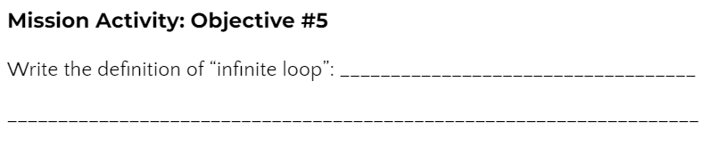
Mission Activity #5
DO THIS:
Go to your Mission Log and write the definition for infinite loop.

Slide 15
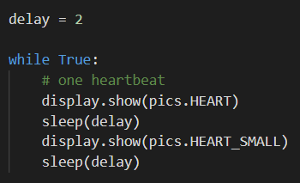
Mission Activity #5
DO THIS:
If your code is still running, click “STOP”
Change the value of delay to 2
Run the code
Click “STOP”
Change the value of delay to 0.5
Run the code
Click “STOP”
OPTIONAL: try different values for delay

Slide 16
Objective #6: Heart break
You still have an infinite loop.
Instead of clicking the “STOP” button, write code to stop the loop
Use a break command
The break command is used in an if statement
Press a button to break out of the loop and stop the program

Slide 17
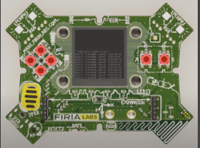

Mission Activity #6
DO THIS:
Click on
Go to your Mission Log and answer the questions for Objective #6

Slide 18
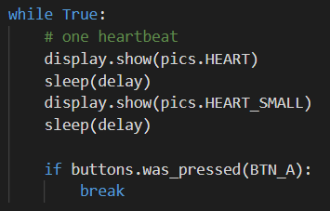
Mission Activity #6
DO THIS:
Add an if statement to the while loop to break out of the loop
  Be careful with the indenting
  Make sure to add a colon (:) after the
  if statement
Run the code
Press the “A” button to stop the code

Slide 19
Objective #7: Explore the beat
Now your CodeX is interactive!
And your coding skills are growing.
You learned about
  Input -- using a button press
  Branching -- if statements with a condition
Now you CodeX can do something different when a button is pressed

Slide 20
Objective #7: Explore the beat
Review the concepts
Branching
  Use an if statement
  Has a condition
  The condition can be True or False
  If the condition is True, the indented code is executed
  If the condition is False, the indented code is skipped

Slide 21


Objective #7: Explore the beat
Review the concepts
Branching Example:
  Use an if statement
  Has a condition
  The condition can be True or False
  If the condition is True, the indented code is executed
  If the condition is False, the indented code is skipped

Slide 22
Objective #7: Explore the beat
Review the concepts
CodeX button input
  Two different functions check for a CodeX button press
  buttons.was_pressed(BTN_A)
    Checks to see if BTN_A was pressed since the last check
  buttons.is_pressed(BTN_A)
    Checks to see if BTN_A is currently pressed
  Both functions are a condition
  Both functions can be used in an if statement
  Both functions evaluate to True or False

Slide 23

Objective #7: Explore the beat
Review the concepts
Branching Example with input:
  Use an if statement
  Has a condition
  The condition can be True or False
  If BTN_A was recently pressed, the indented code is executed
  If a different button was recently pressed, the indented code is skipped

Slide 24

Mission Activity #7
Experiment with the code
DO THIS:
Click the debugger button
Use the Step Over button to watch the branching
You must step at least 8 times
Go through the while loop one time
Then press BTN_A and go through the loop again
The code should break out of the loop and stop
Step Over
Stop

Slide 25

Break-fast quiz
During this mission you have learned about branching and buttons for input
Answer the 2 quiz questions
CODEX
QUIZ

Slide 26
Objective #8: Half a sleep
You can make the heart beat faster!
What controls the speed of the beat so far?
The delay variable
sleep()
To beat faster, the delay variable needs to be a smaller value

Slide 27
Objective #8: Half a sleep
But what is smaller than delay = 1?
There isn’t an integer less than 1 that can be used for delay
You need to use a real number, or decimal, like 0.5 or 0.75
The decimal in the number is called a “floating point”
The data type for a real number is float
1.2
41.003
0.5
3.125
0.79
8.01

Slide 28
Objective #8: Half a sleep
Now you know five data types:
Integer (Examples: 1, 54, 720)
CodeX image (Examples: pics.HEART, pics.MUSIC)
String (Examples: “Hello”, “Press A”, “cake”)
Boolean (Values: True, False)
Float (Examples: 0.5, 3.125, 49.02)

Slide 29
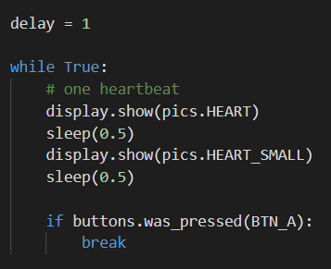
Mission Activity #8
DO THIS:
Set the value of delay to 1
Use the float value 0.5 in the two sleep() commands
Run the code
After a few fast heartbeats, press BTN_A to stop the program

Slide 30
Objective #9: Variable speed control
You can change the speed of the heartbeat by changing the value of the variable delay.
You will need your delay variable
You will need to use it in the sleep() command

Slide 31
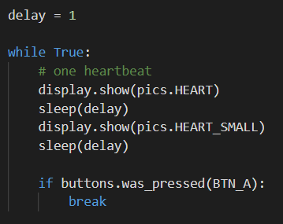
Mission Activity #9
DO THIS:
Use the delay variable in the 2 sleep() commands
Run the code
After a few fast heartbeats, press BTN_A to stop the program

Slide 32

Objective #10: Brake! not break
With a variable, your heartbeat speed is easy to change.
You can change the speed while the program is running
Use the buttons to change the value of delay
Look at the code below:

Slide 33

Objective #10: Brake!, not break
Look carefully at the indented code:
This doesn’t make sense in math, but it does make sense to a computer
The original value of delay is 1, or 1.0
Then 0.2 is added to the current value
The new value is assigned to delay, like this:

Slide 34
Objective #10: Brake!, not break
Adding a set amount, like 0.2, to a variable is called increment
In this code, every time BTN_A is pressed, the delay will increase by 0.2
A larger number for delay will slow down the heartbeat (a longer sleep)

Slide 35
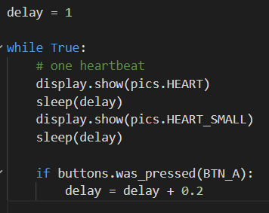
Mission Activity #10
Ready to try? Your first goal is to slow down the heartbeat.
DO THIS:
Change the if statement
Remove “break”
Replace it by incrementing delay
Run the code and press BTN_A a few times
The heartbeat should slow down each time
Press the STOP button to stop the program

Slide 36

Objective #11: Variable speed heart
You added code to slow down the heartbeat. Now add code to speed up the heartbeat.
Use BTN_B
The code will be almost the same as the if statement for BTN_A

Slide 37

Objective #11: Variable speed heart
Look carefully at the indented code:
The original value of delay could be 1.0, or 1.2, or 1.4
In this code, 0.2 is subtracted from the current value
Then the new value is assigned to delay, like this:

Slide 38
Objective #11: Variable speed heart
Subtracting a set amount, like 0.2, to a variable is called “decrement”
In this code, every time BTN_B is pressed, the delay will decrease by 0.2
A smaller number for delay will speed up the heartbeat

Slide 39
Objective #11: Variable speed heart
When you add the if statement, you can speed up and slow down the heartbeat with the press of two buttons
But … be careful!
Pressing BTN_B several times can give a 0 or negative value for delay
The sleep() function must have a positive value!
So, an error will occur if BTN_B is pressed too many times.

Slide 40
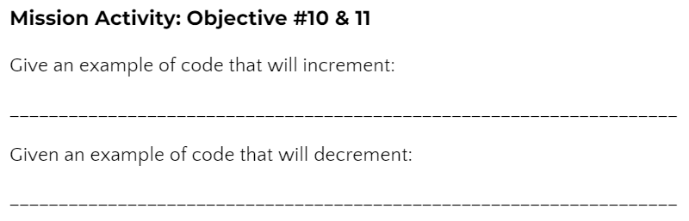
Mission Activity #11
DO THIS:
Go to your Mission Log and complete the questions for Objective #10 and Objective #11

Slide 41
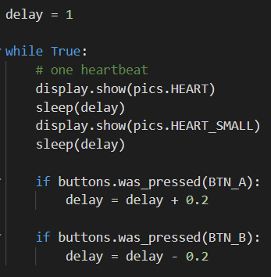
Mission Activity #11
Complete the second goal to speed up the heartbeat.
DO THIS:
Add an if statement for BTN_B to decrement delay
Run the code and press BTN_A a few times and BTN_B a few times
The heartbeat should slow down and speed up
Press BTN_B enough times to cause an error and stop the program

Slide 42
Heartfelt Recap quiz
During this mission you have learned about changing the value of delay to change the heartbeat.
Answer the 2 quiz questions
CODEX
QUIZ

Slide 43
Post-Mission Reflection
Read the “completed mission” message and click to complete the mission
Complete the Mission 6 Log

Slide 44
Clearing your CodeX
Go to FILE -- BROWSE FILES
Select the “Clear” file and open it
Run the program to clear the CodeX

